Slide 1
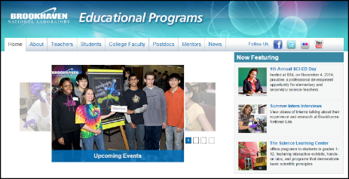
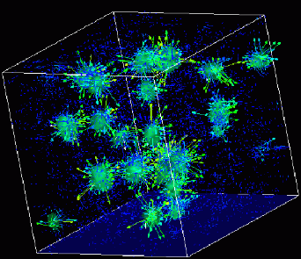

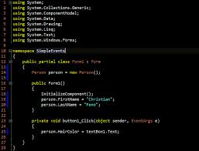
Advanced
Scientific Computing
(SciComp 201)
Session 17
Polar Coordinates, Parametric Equations

Slide 2
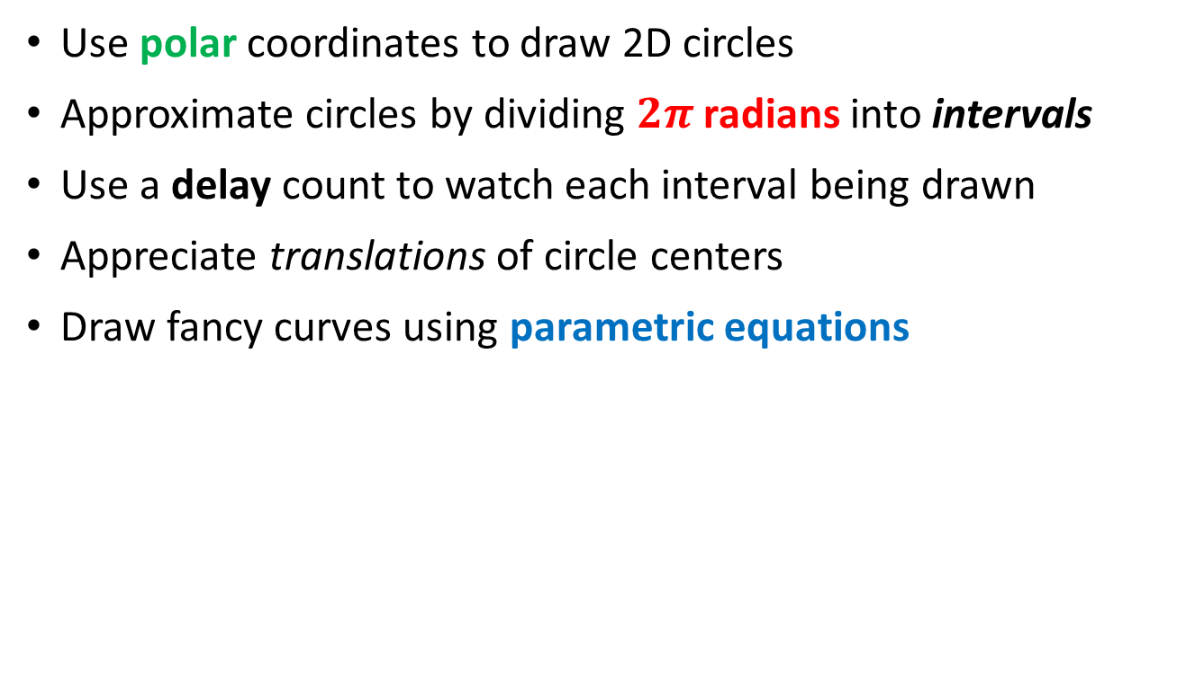
Session Goals
Use polar coordinates to draw 2D circles
Approximate circles by dividing $2π$ radians into intervals
Use a delay count to watch each interval being drawn
Appreciate translations of circle centers
Draw fancy curves using parametric equations

Slide 3
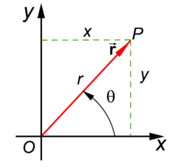
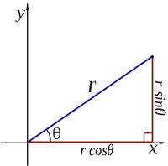
Polar Coordinates
A radius and an angle (theta)
make a 2D polar coordinate
$$(r∗\cos{θ, r ∗ \sin{θ)}}$$

Slide 4
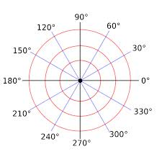
Polar Coordinates

Slide 5
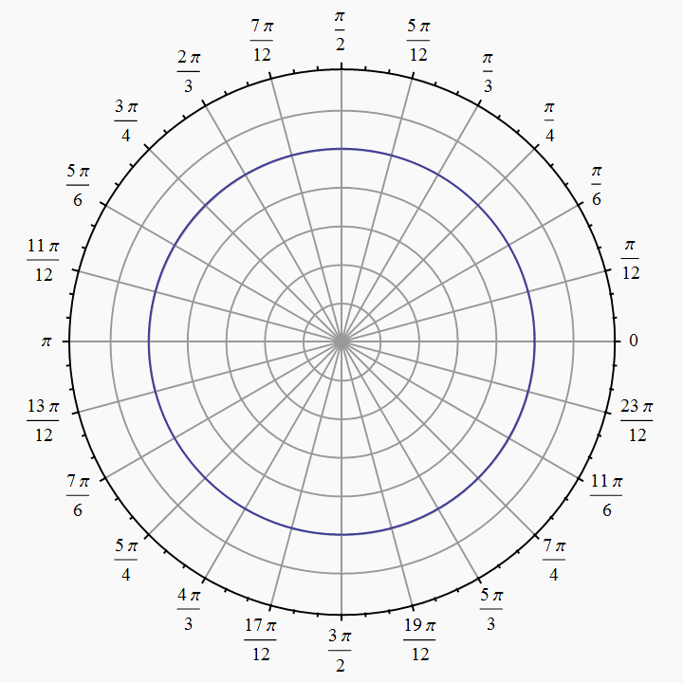
Polar Coordinates
Angles are measured in
radians
(0 ≤ θ ≤ $2π)$

Slide 6
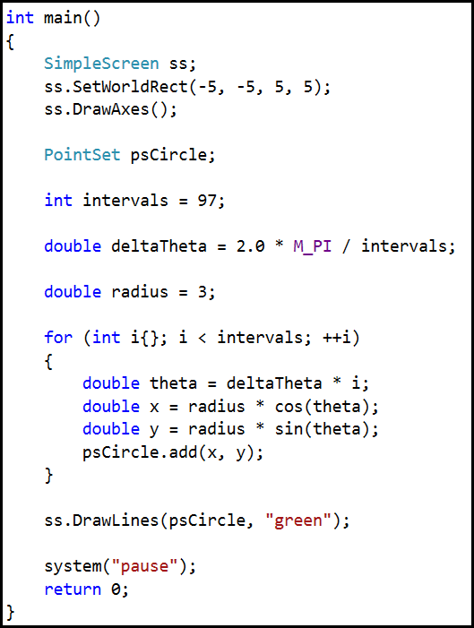
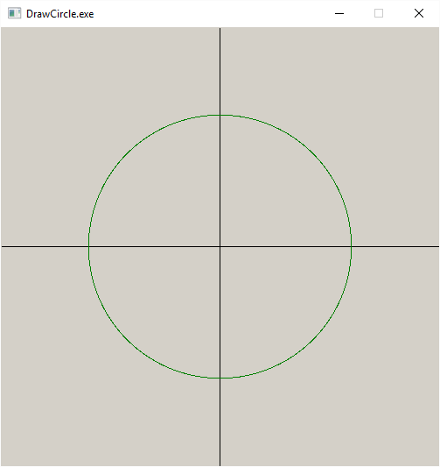
Lab 3 – Draw Circle

Slide 7
Lab 1 – Draw Circle
Change intervals to 8
Change call to DrawLines() and run app each time:
ss.DrawLines(psCircle, "green", 1, false);
ss.DrawLines(psCircle, "green", 1, true, true);

Slide 8
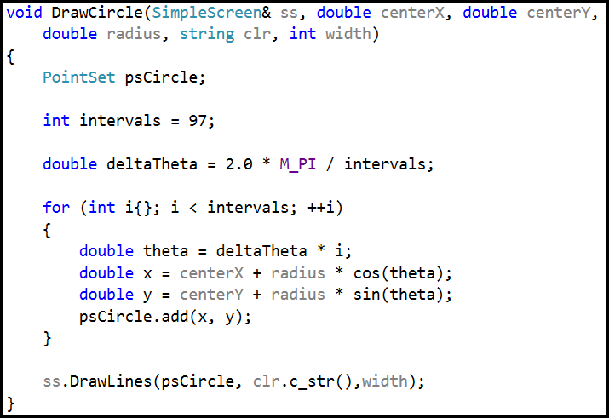
Lab 2 – Draw the Olympic Rings

Slide 9

Lab 2 – Draw the Olympic Rings
ringOffsetFullX
(0,0)
ringOffsetY
ringOffsetHalfX

Slide 10
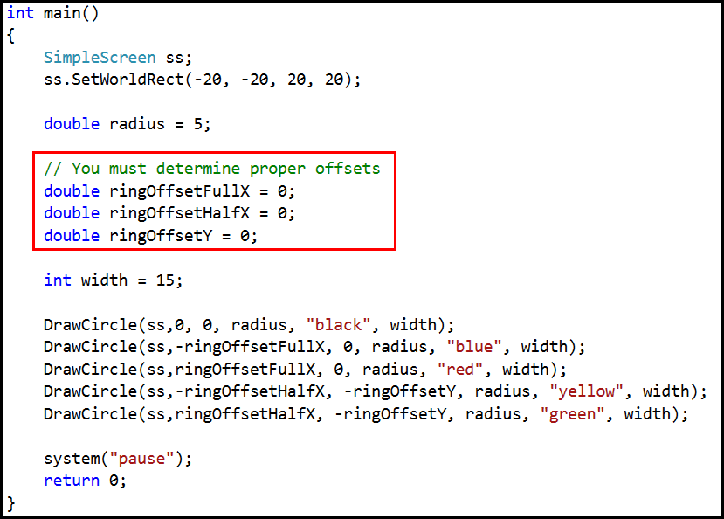
Lab 2 – Draw the Olympic Rings

Slide 11
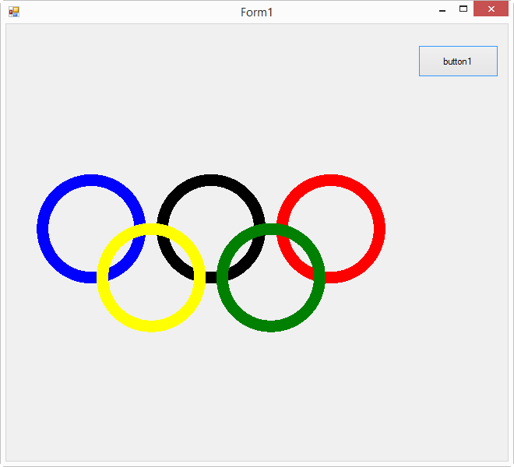

Lab 2 – Draw the Olympic Rings

Slide 12
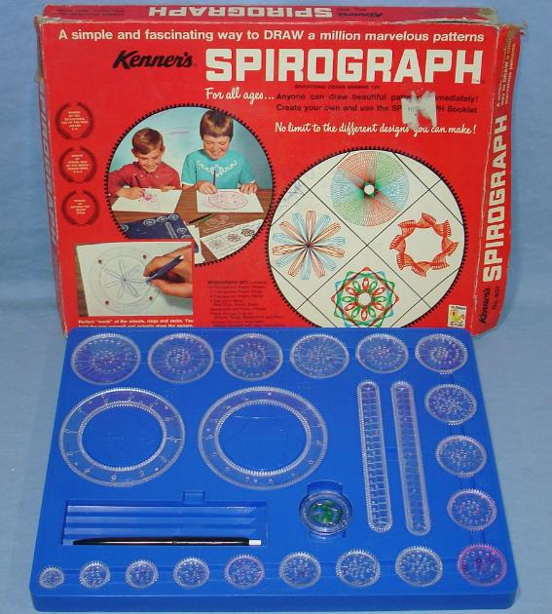
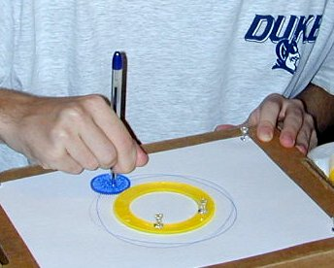
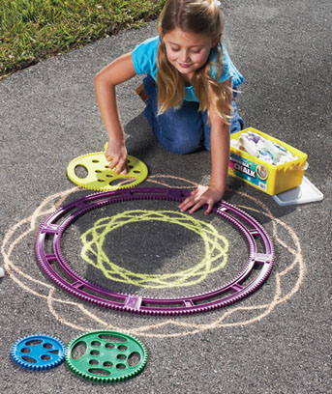
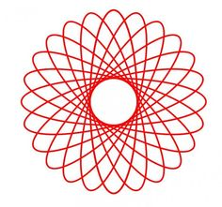
Parametric Curves

Slide 13
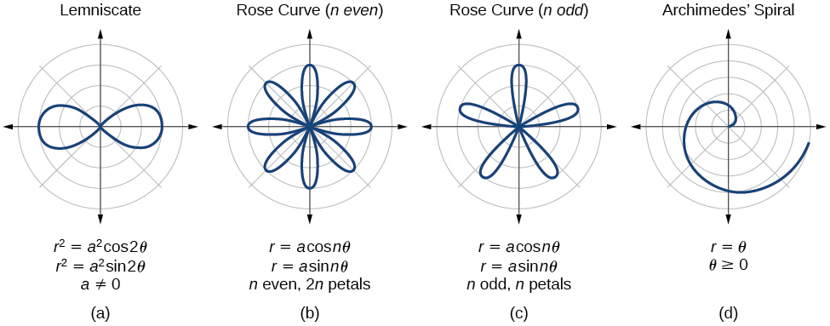
Parametric Curves
The two parameters a, n are used to calculate the current radius $r$ as $θ$sweeps the circle

Slide 14
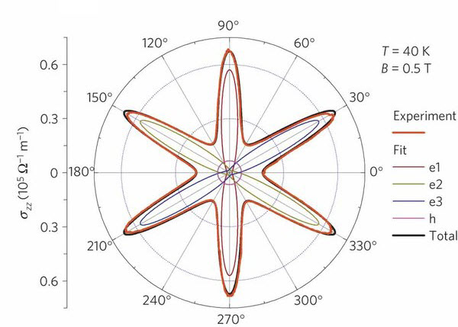
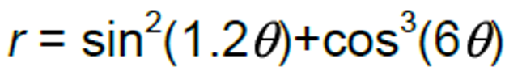
Parametric Curves
Field Induced Polarization of Dirac Valleys in Bismuth*
*Bismuth is the element with the highest atomic mass that is stable

Slide 15
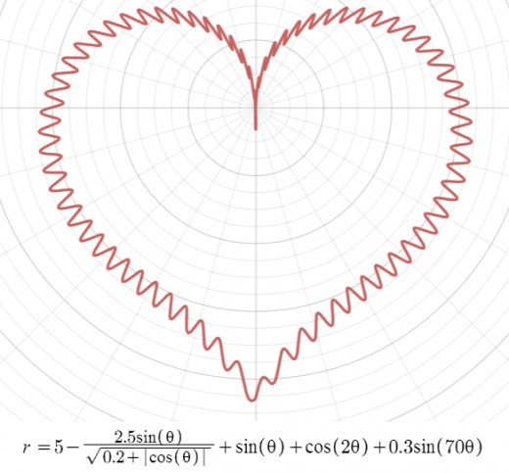
Parametric Curves

Slide 16
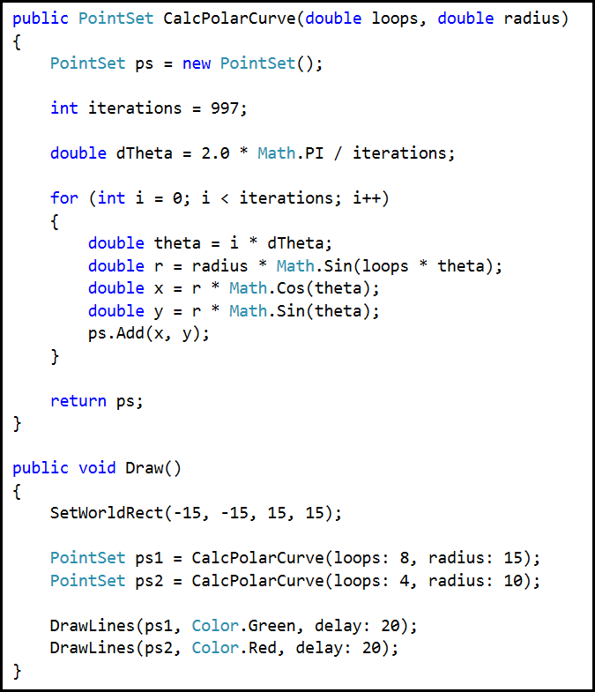
Parametric Curves
These two parameters are used to calculate the current radius $r$ as $θ$sweeps the circle
Open and run Lab 3

Slide 17
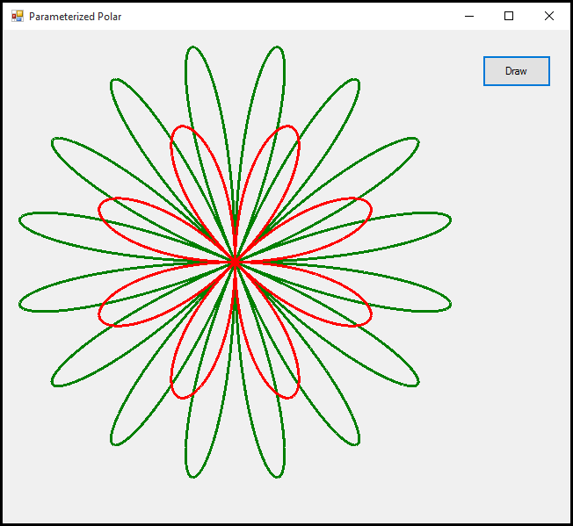
Lab 3 - Parametric Curves
The key points are:
The radius is changing while $θ$is changing
The shape of the curve depends on two parameters

Slide 18
Now you know…
How to create and populate elements of a PointSet
How to use the Draw() method of class SimpleScreen
Select a World rectangle to frame the view
How to use polar coordinates to draw 2D circles
How to approximate circles by drawing small intervals
We can draw fancy curves by using parametric equations

